Slide 1
One Work Order Flow: Inputs

Slide 2
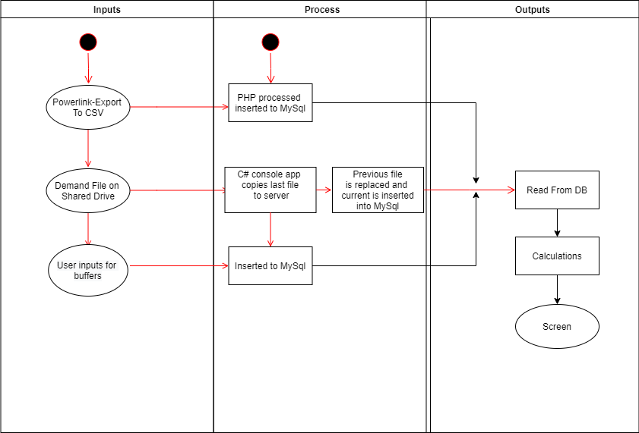
Data inputs
8/11/2021: Our challenge is to develop a small console app that will run continuously to get the demand file , this app will select the newest file and copy its contents to the server were it will be read and saved to db

